Slide 1
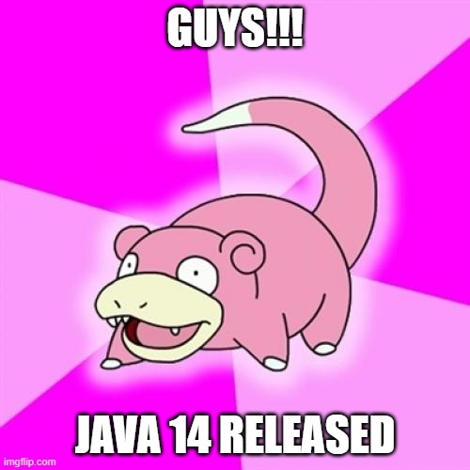
Java 14: what’s new
*Release was on the 17th of March 2020

Slide 2
Changes in Java distribution
Lot of things changed after 16/04/19.
How it affects me?

Slide 3

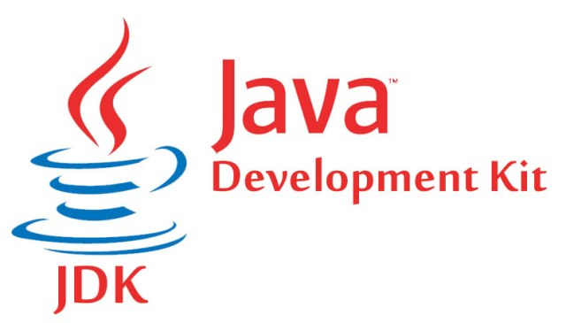
What’s changed?
Oracle always supported OpenJDK and OracleJDK:
- both were free
- had some functional differences

Slide 4
License agreement has changed for OracleJDK starting from Java SE 8 updates after January 2019:
You may not: use the Programs for any data processing or any commercial, production, or internal business purposes other than developing, testing, prototyping, and demonstrating your Application;

Slide 5
What’s changed?
GNU GPL v2 + CPE
Oracle Binary Code License Agreement

Slide 6
YES
Does this affects JRE?
Both JDK and JRE are affected

Slide 7
Any difference?
no real technical difference
build process for the Oracle JDK is based on OpenJDK.
Can be used in PROD for free
Performance is good enough for PROD
6 months of support
Should pay for commercial license
Performance is better
LTS (5 years)

Slide 8
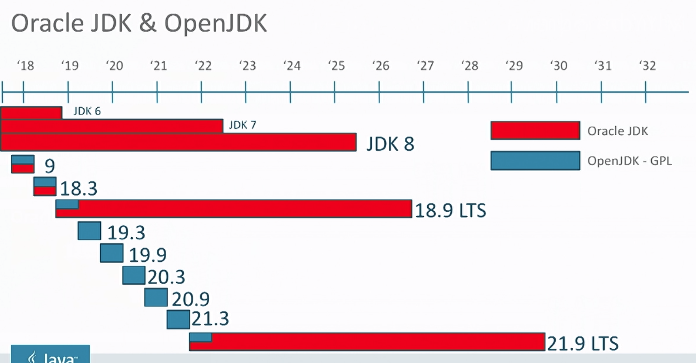
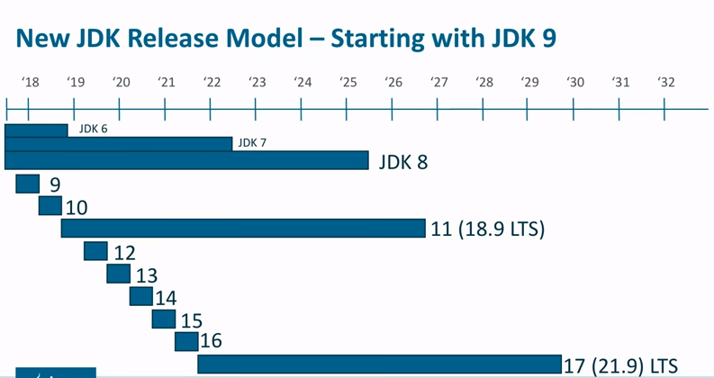
Release cycle

Slide 9
Some more bureocracy
How proposal for features work?

Slide 10
How to make a proposal?
JEP
JSR
Commitee
JCP
JDK Enhancement Proposal
(informal JCP)
Java Specification Request
Best representatives from the best companies. Rotation each year.
Java Community Process
Notes:
:

Slide 11
JCP flow
1
2
3
4
Invitation
Community review of the draft
Public review and approval
Maintenance
JSR reviewed, JSR approved, Expert Group Formed
1-3 months of community review
Specification, Tech compatibility kit, reference implementation release
Maintenance Lead review, executive committee vote
https://www.jcp.org/en/procedures/overview

Slide 12
JEP-12: Preview features
A preview feature is a new feature of Java language, that is fully specified, fully implemented, and yet impermanent. Provokes developer feedback based on real world use. Can become permanent in the future.
For example in Java 11 we had experimental options:
-XX:+UnlockExperimentalVMOptions -XX:+UseZGC

Slide 13
Finally! Let’s move to features
Brief overview

Slide 14
Language features
1
Features that 99% of you can and will use

Slide 15
JEP-359
Records

Slide 16

JEP-359: Records (aka data classes)
Preview feature (-enable-preview -release 14)
Part of Valhalla Project
New syntax in language
Future: https://openjdk.java.net/jeps/384

Slide 17
JEP-359: Records (aka data classes)
final class Person { private final String name; private final String surname; public Person(String name, String surname) { this.name = name; this.surname = surname; } @Override public boolean equals(Object o) { if (this == o) return true; if (o == null || getClass() != o.getClass()) return false; Person person = (Person) o; return Objects.equals(name, person.name) && Objects.equals(surname, person.surname); } @Override public int hashCode() { return Objects.hash(name, surname); } @Override public String toString() { return ""; } public String getSurname() { return surname; } public String getName() { return name; } }

Slide 18



JEP-359: Records (aka data classes)
public record Person(String name, String surname){}
All needed methods are generated by compiler
Final, cannot be abstract

Slide 19
JEP-359: Records (aka data classes)
public final class Person extends java.lang.Record { private final java.lang.String name; private final String surname; public Person(java.lang.String name, String surname) { /* compiled code */ } public java.lang.String toString() { /* compiled code */ } public final int hashCode() { /* compiled code */ } public final boolean equals(java.lang.Object o) { /* compiled code */ } public java.lang.String name() { /* compiled code */ } public String surname() { /* compiled code */ } }

Slide 20
JEP-305
Pattern matching

Slide 21

JEP-359: Pattern matching for instanceof
Preview feature (-enable-preview -release 14)
Future: http://openjdk.java.net/jeps/375
New syntax in language

Slide 22
JEP-359: Pattern matching for instanceof
Before Java 14
Object obj = "Ivan loves instanceof"; if (obj instanceof String) { String s = (String) obj; System.out.println(s.length()); }

Slide 23
JEP-359: Pattern matching for instanceof
After Java 14
Object obj = "Ivan loves instanceof";
if (obj instanceof String s){ System.out.println(s.length()); }

Slide 24
JEP-358
Helpful NPE

Slide 25

JEP-358: Helpful NullPointerExceptions
Java removed NPE? – of course NO!
Simply enhanced logging!

Slide 26
JEP-358: Helpful NullPointerExceptions
Before Java 14
DemoClass superNpeFeature = init(); superNpeFeature.getData().getSpecialInfo().getName();
Exception in thread "main" java.lang.NullPointerException at Main.main(Main.java:13)

Slide 27
JEP-358: Helpful NullPointerExceptions
After Java 14
DemoClass superNpeFeature = init(); superNpeFeature.getData().getSpecialInfo().getName();
Exception in thread "main" java.lang.NullPointerException: Cannot invoke “SpecialInfo().getName()" because the return value of “Data().getSpecialInfo()" is null at Main.main(Main.java:12)

Slide 28
JEP-361
Switch enabled by the default

Slide 29

JEP-361: Switch Expressions (Standard)
Switch already worked in Java12 and Java13
Not a preview feature anymore
Now is a part of permanent standard
New syntax and new ‘yield’ keyword

Slide 30
JEP-361: Switch Expressions
Before Java 14
int numLetters; switch(day){ case MONDAY: case FRIDAY: case SUNDAY: numLetters=6; break; case TUESDAY: numLetters=7; break; case THURSDAY: case SATURDAY: numLetters=8; break; case WEDNESDAY: numLetters=9; break; default: throw new IllegalStateException("How?: " + day); }

Slide 31
JEP-361: Switch Expressions
After Java 14
int numLetters = switch (day) { case MONDAY, FRIDAY, SUNDAY -> 6; case TUESDAY -> 7; case THURSDAY, SATURDAY -> 8; case WEDNESDAY -> 9; };

Slide 32
JEP-361: Switch Expressions
Also: yield keyword
int j = switch(day) { case MONDAY -> 0; case TUESDAY -> 1; default -> { int k=day.toString().length(); int result=f(k); yield result; // <<<< } };

Slide 33
JEP-368
Text blocks being changed again!

Slide 34
JEP-368: Text Blocks (Second Preview)
Still a preview feature
Added some changes to JEP-355: Text Blocks (Preview)
Will be different from the Java 13 version

Slide 35
JEP-368: Text Blocks (Second Preview)
Before Java 13
String html = "<html>\n" + " <body>\n" + " <p>Hello, world</p>\n" + " </body>\n" + "</html>\n";

Slide 36
JEP-368: Text Blocks (Second Preview)
In Java 13
String html = """ <html> <body> <p>Hello World</p> </body> </html> """;

Slide 37
JEP-368: Text Blocks (Second Preview)
After Java 14
String text = """ Here I want spaces in the end not being trimmed: \ Here I will use the second version of this feature: \s This will work? Nice! """;
\ - added for newline
\s – added for explicit space

Slide 38
Tools and libs
2
Features that 10% of you will use, speedrun

Slide 39
JEP-343
Incubator

Slide 40
JEP-343: Packaging Tool (Incubator)
Simple packaging tool
Similar to JavaFX: javapackager
Supports natural packaging formats
tools/jpackage (jdk.incubator.jpackage)

Slide 41
JEP-343: Packaging Tool (Incubator)
Example of usage:
$ jpackage --name myapp --input lib --main-jar main.jar --type exe
msi/exe on Windows
pkg/dmg on macOS
deb/rpm on Linux.

Slide 42
JEP-349
Java Flight Recorder

Slide 43
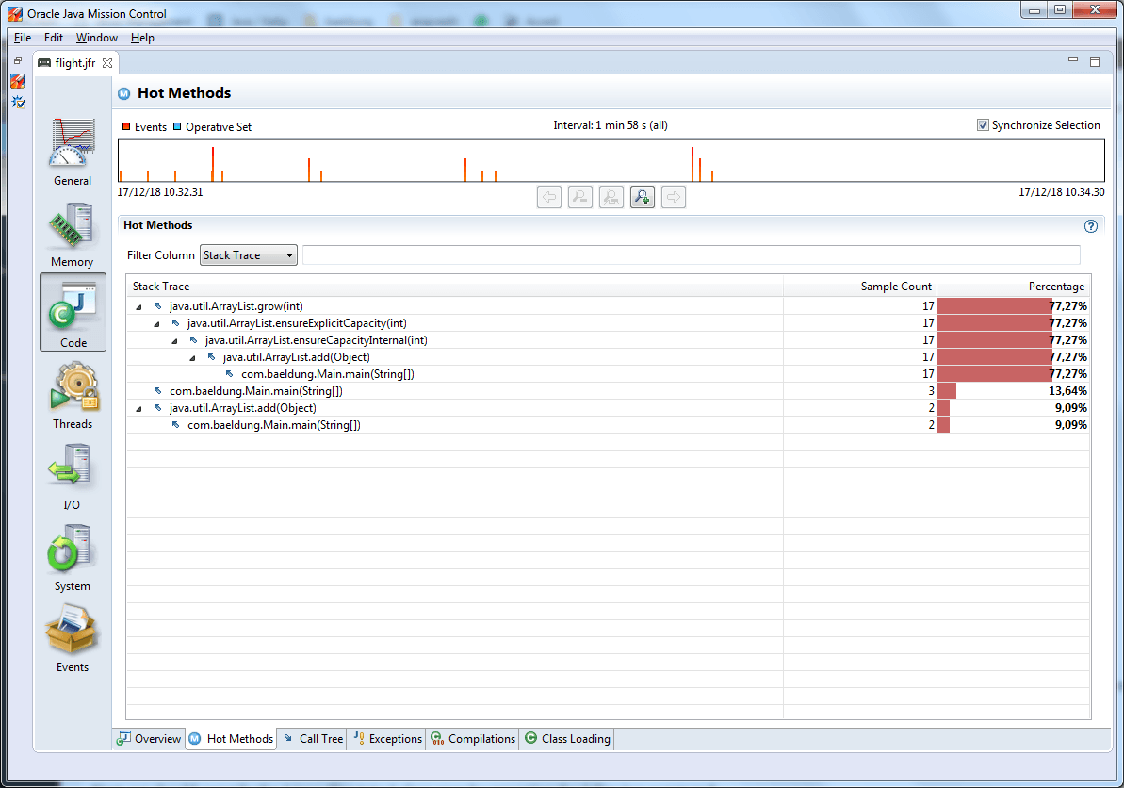
JEP 349: JFR Event Streaming
JFR – monitoring tool that can be used as plugin in Java Mission Control
Continuous monitoring with 1% overhead
I love good old jconsole, never used JMC/JFR

Slide 44
JEP-364-365
ZGC on Mac/Win

Slide 45
JEP 364-365: ZGC on Mac/Win
ZGC introduced for Win/Mac
New experimental GC from Java 13
Concurrent GC with stop the world <10ms that can support multi-terabytes heap
XX:+UnlockExperimentalVMOptions -XX:+UseZGC
In Russia we love Shenandoah GC

Slide 46
Things that you will not even notice
3
Features that 0% of you will notice

Slide 47
You won’t notice it
G1 finally supports Non-uniform mem access architecture (performance) http://openjdk.java.net/jeps/345
MappedByteBuffer support access to non-volatile memory (stability) https://openjdk.java.net/jeps/352
Finally Solaris/SPARC, Solaris/x64 and Linux/SPARC ports deprecated https://openjdk.java.net/jeps/362
Concurrent Mark Sweep (CMS) removed https://openjdk.java.net/jeps/363
Pack200 (1.5 archiver) finally removed http://openjdk.java.net/jeps/367

Slide 48

Thanks!
DO YOU HAVE ANY QUESTIONS?

